Slide 1
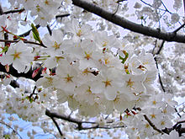
Cherry Blossom Viewing
Hanami

Slide 2
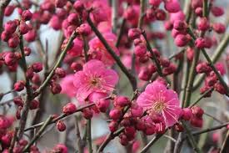
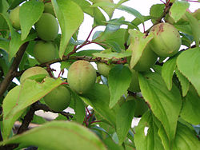
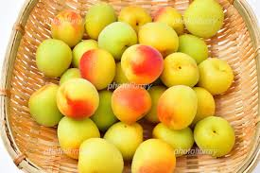
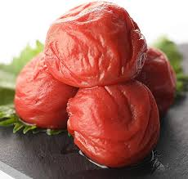
History of Hanami
8th Century
Ume blossoms, were popular for Hanami.
(Japanese apricots)
umeboshi

Slide 3
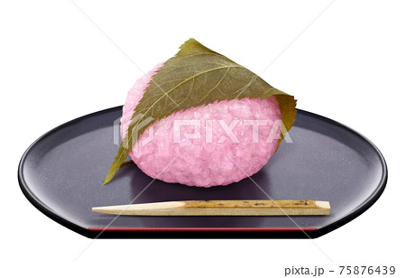
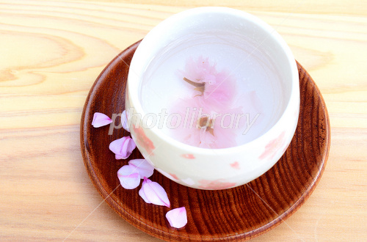
🌸Sakurayu
🌸Sakuramochi
9th Century
Cherry blossoms🌸 are popular for Hanami

Slide 4
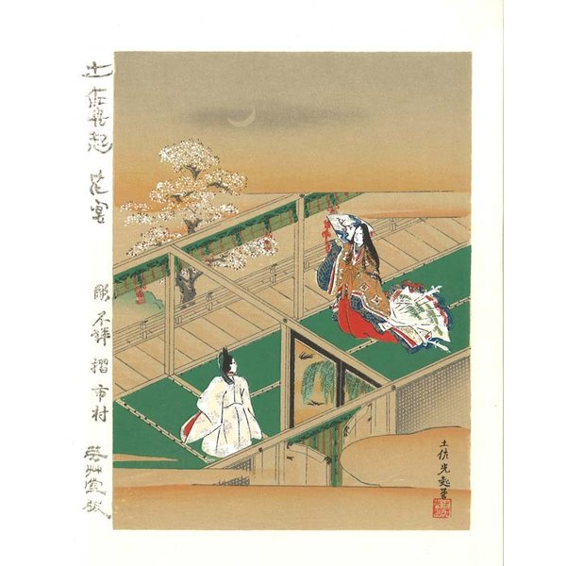
Hanami
was spread Imperial Family
・Oldest record of Hanami
Emperor Saga held
hanami party in 812
・The Tale of Genji
by courtlady

Slide 5
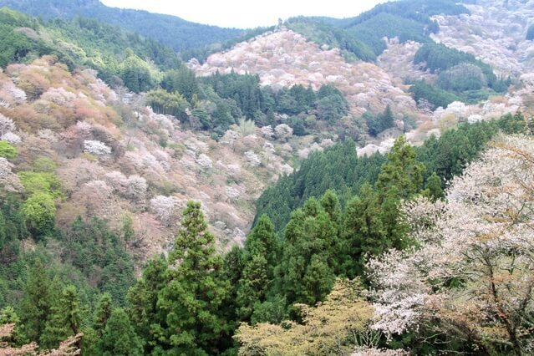
2 Hanami Parties by Hideyoshi
#1 Yoshino Hanami in 1594
5000 Samurai were invited.
for 5 days long!
with Tea Ceremony
making poems
Performing Noh plays

Slide 6
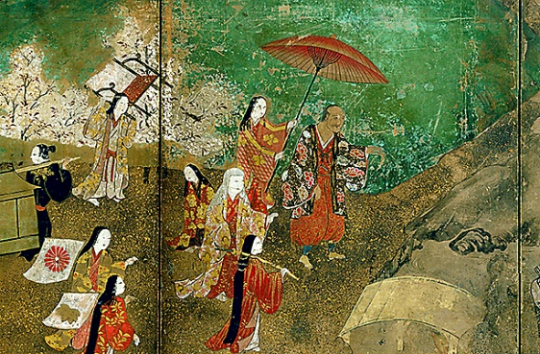
Hanami-2
#2 Daigo in 1598
1300 women were invited.
They changed Kimono
2 times!

Slide 7
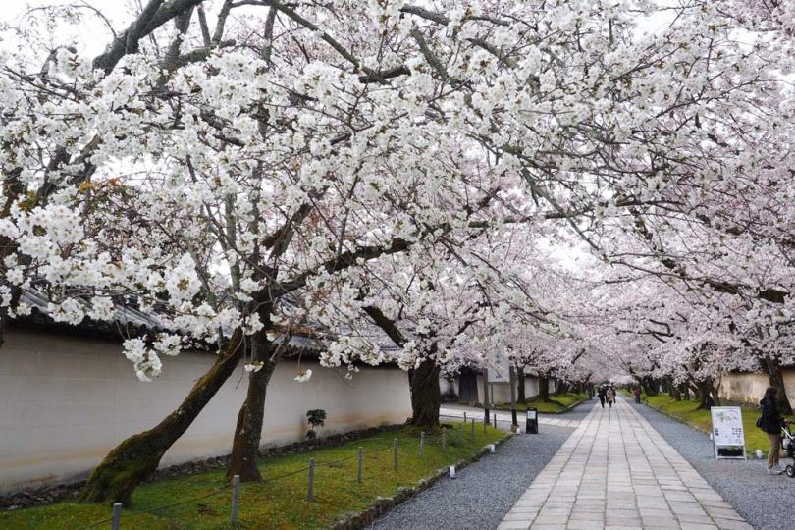
Daigoji

Slide 8
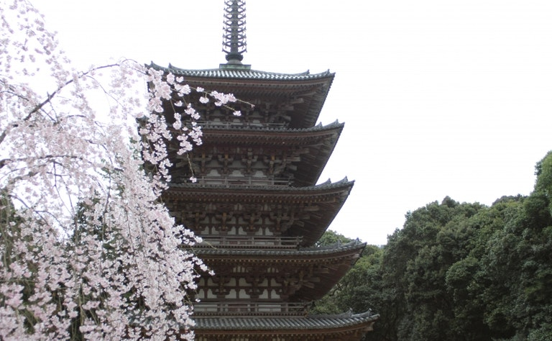

Slide 9
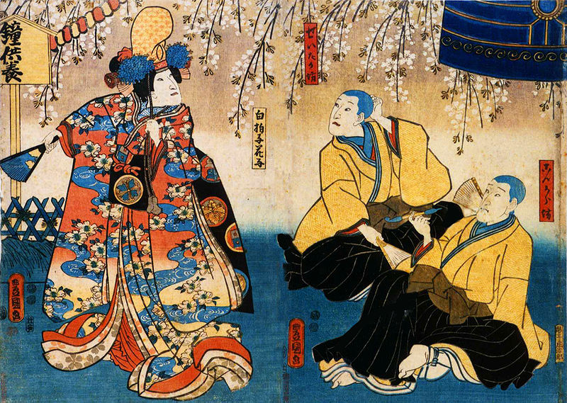
Cherry Blossoms in Kabuki
Drama performed only by male actors

Slide 10
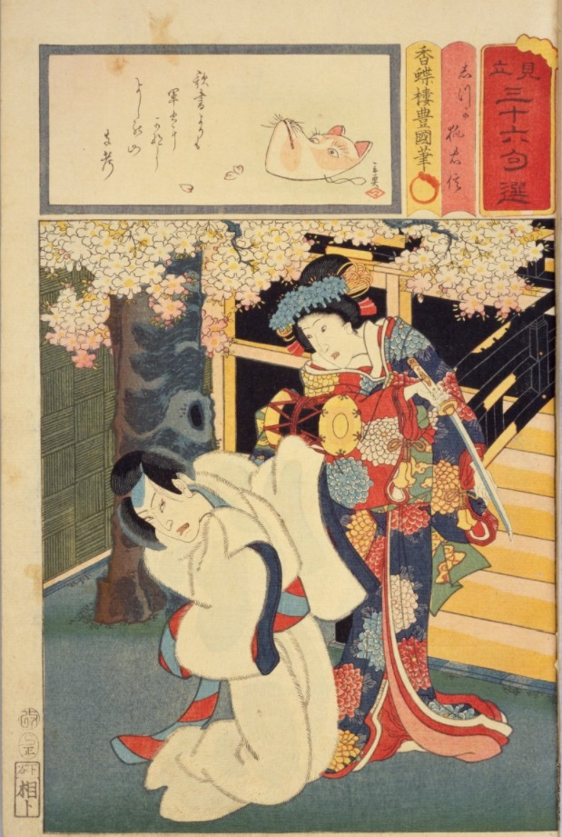
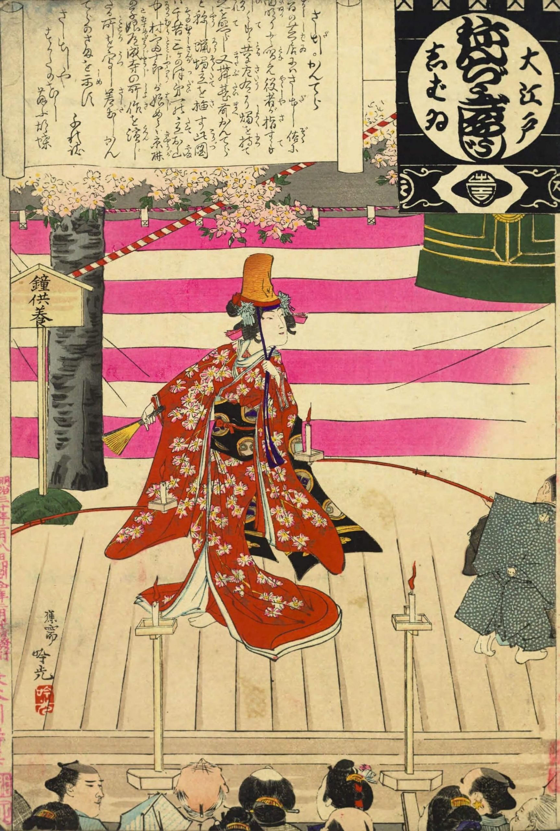

Slide 11
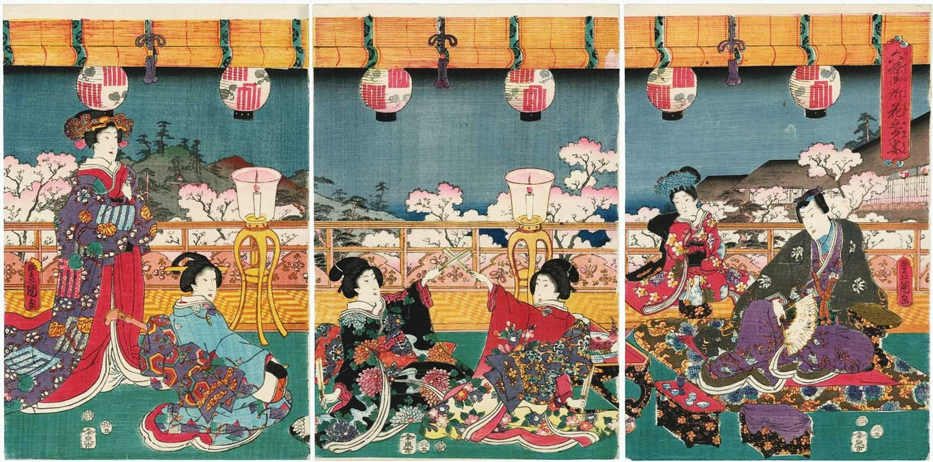
Imperial Palace in Kyoto with court ladies

Slide 12
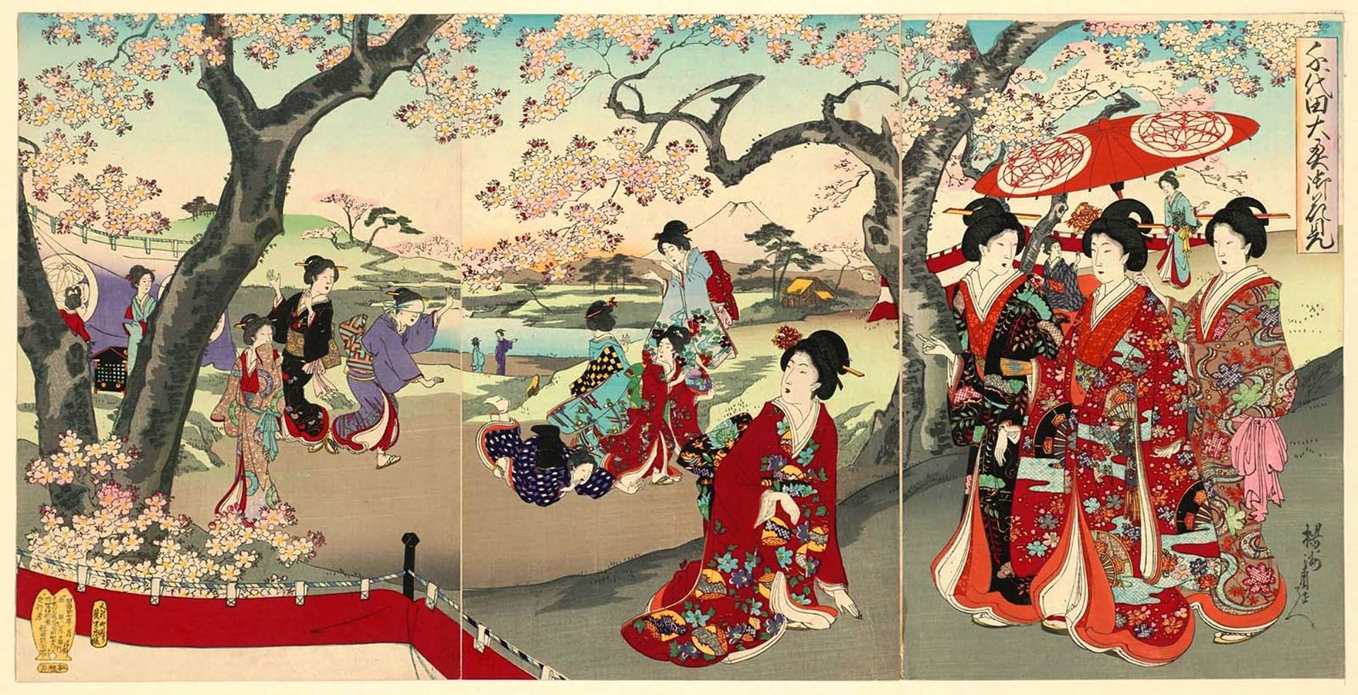
Edo Castle

Slide 13
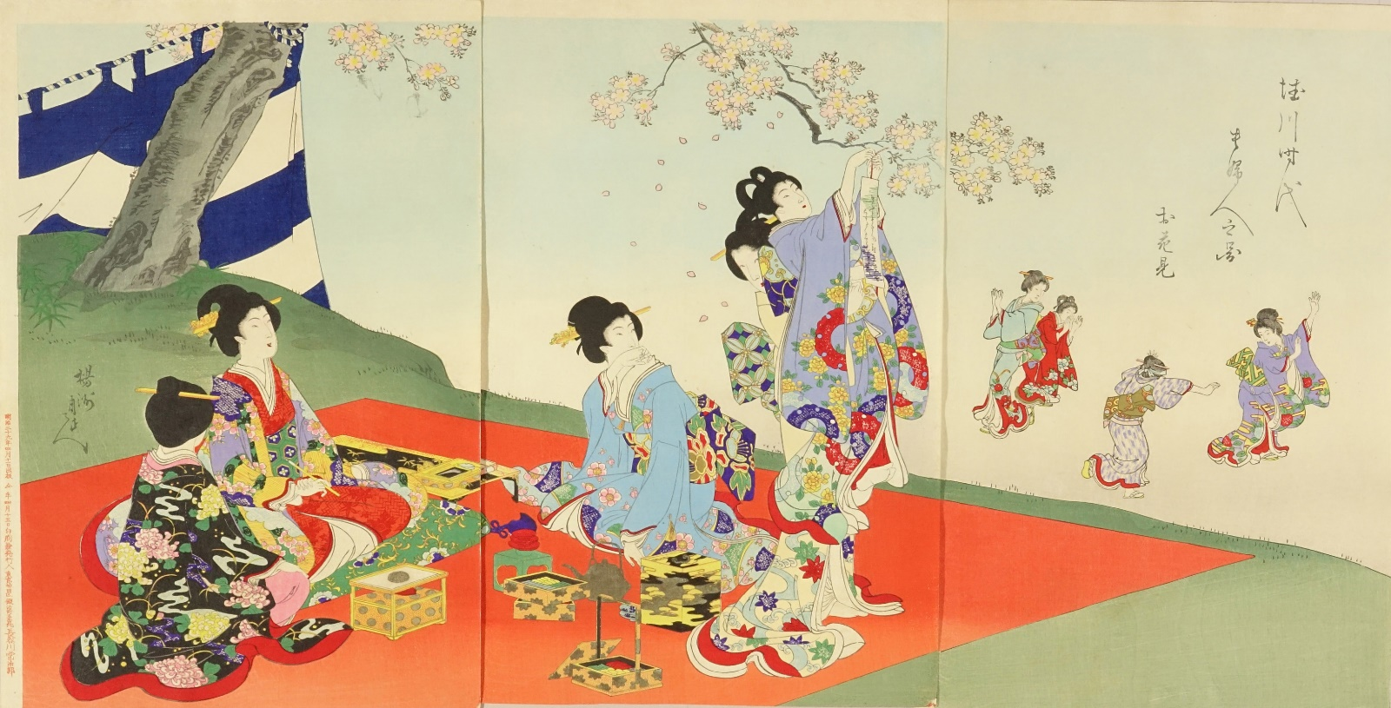
anami

Slide 14
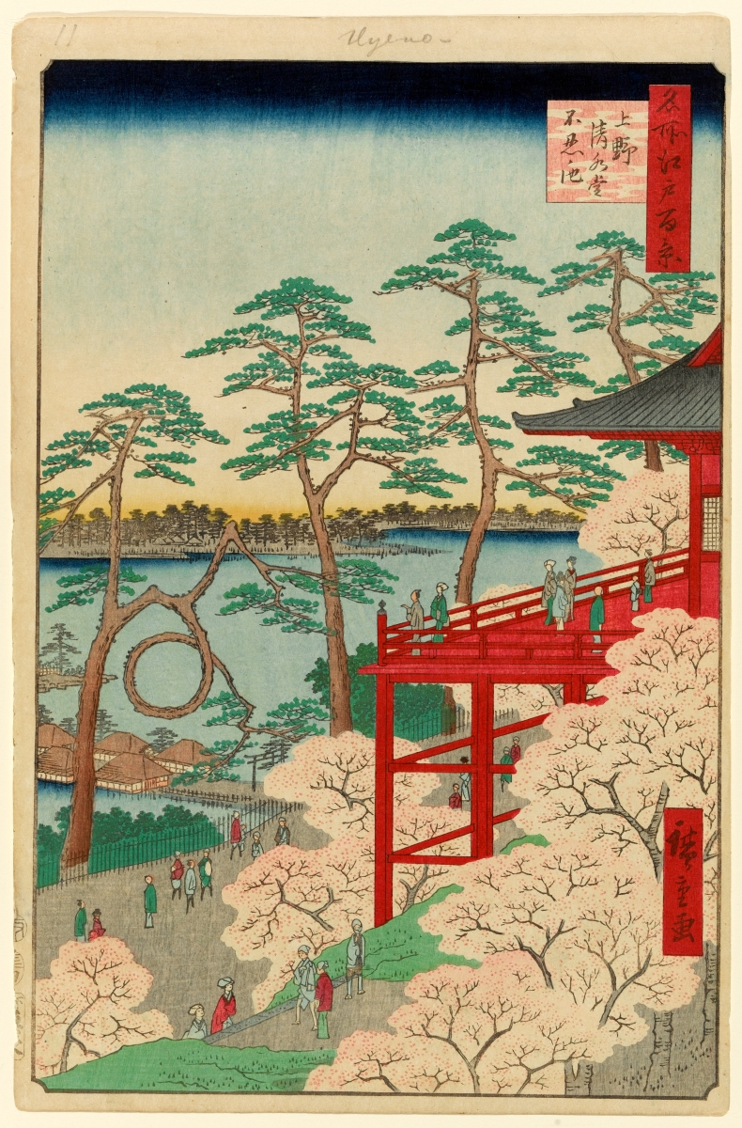
Ukiyoe
Ueno Park
広重

Slide 15
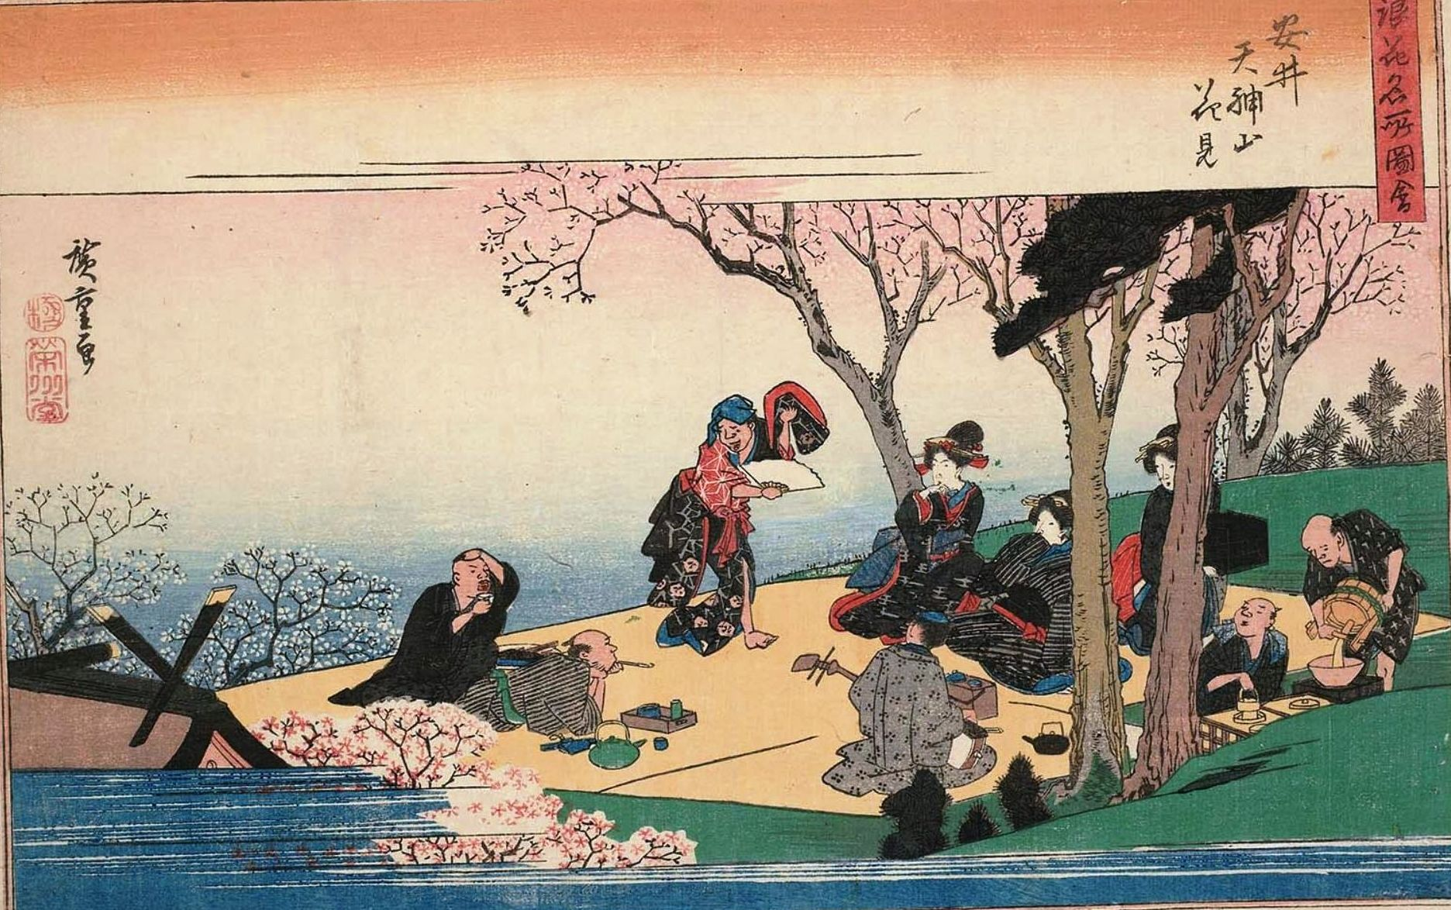
Hanami Party
Dancing
Singng
Sake

Slide 16
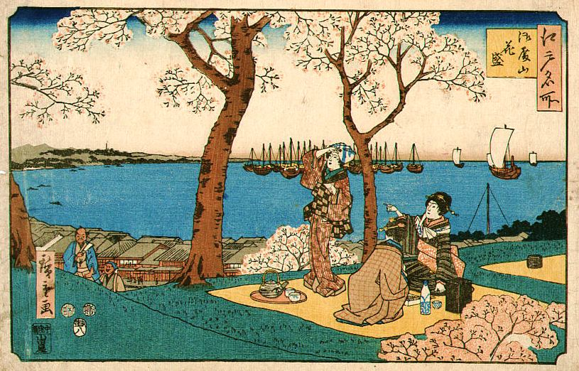
Hanami Bento
Sake

Slide 17
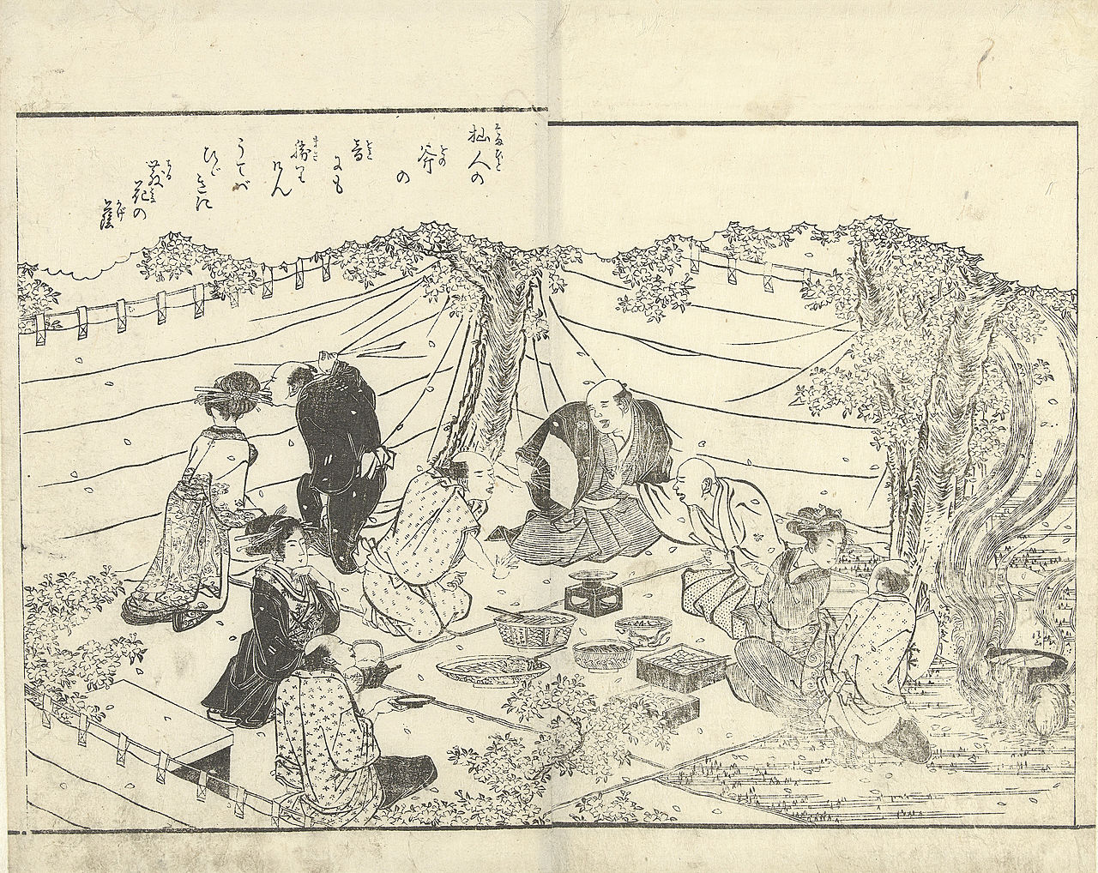

Slide 18
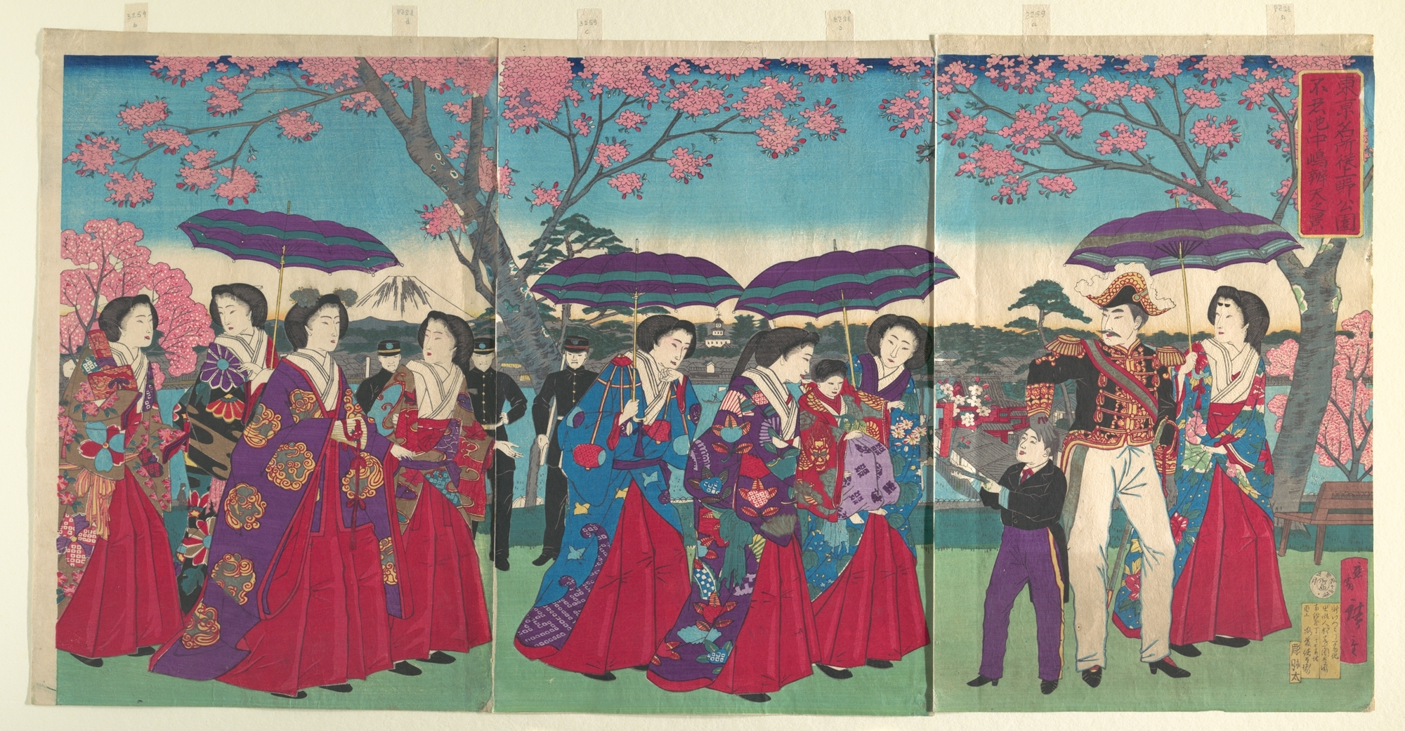
Ueno Park in Meiji Era
During the Tokugawa Shogunate, Japan has closed the door to Foreign Countries.
In Meiji, we opened the door to the World

Slide 19
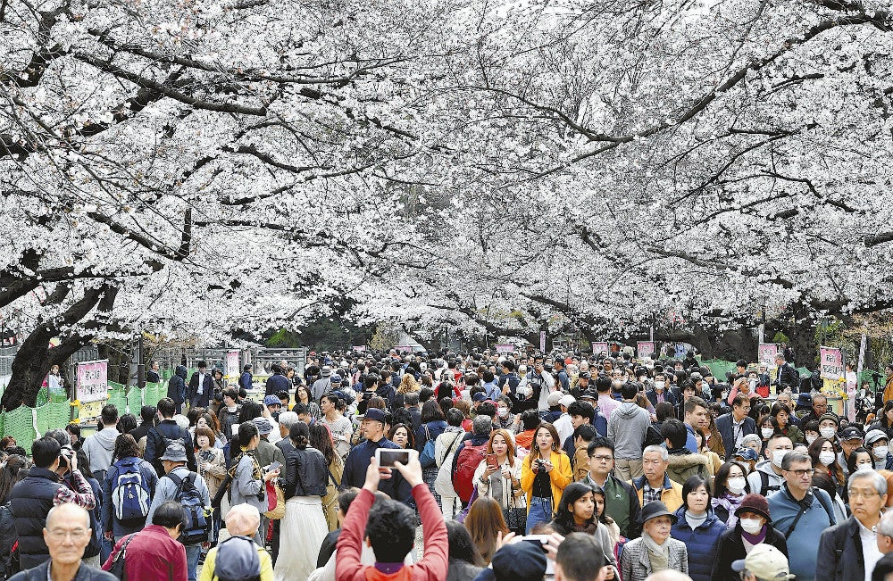
Ueno Park in 2019

Slide 20
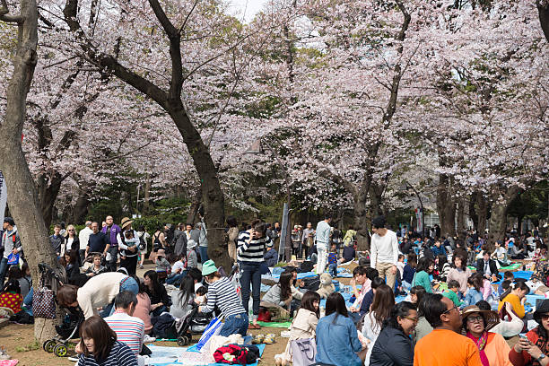
Ueno Park

Slide 21
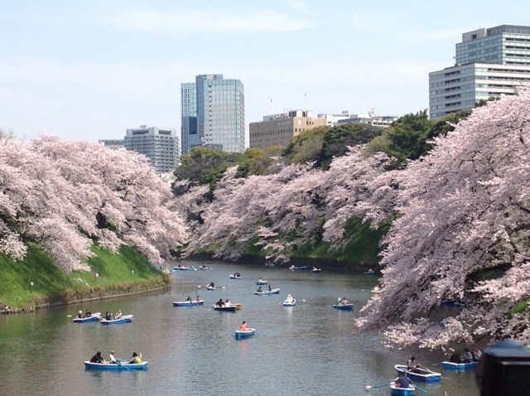
Inner Moat of the Imperial Palace Enjoy Rowing BoatI

Slide 22
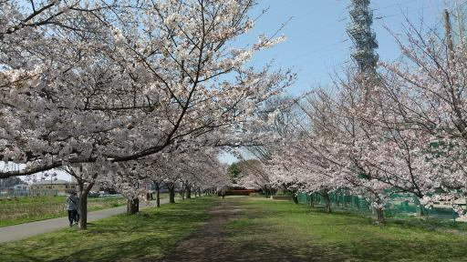
Kashiwa Oohorigawa Riverside
Riverside

Slide 23
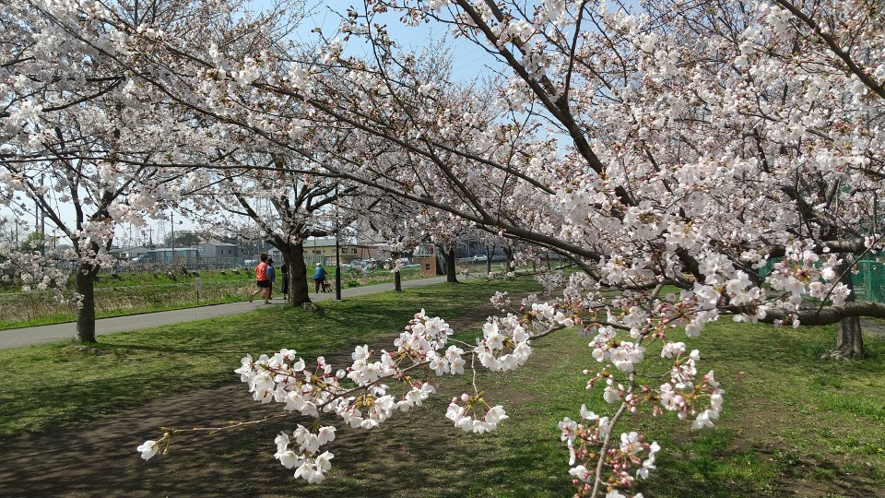
Kashiwa

Slide 24
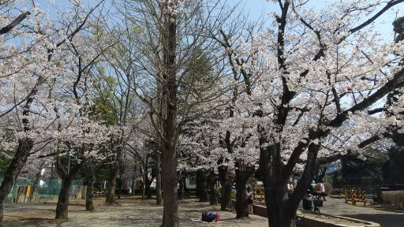
Kashiwa Nishiguchi Park

Slide 25
